Slide 1



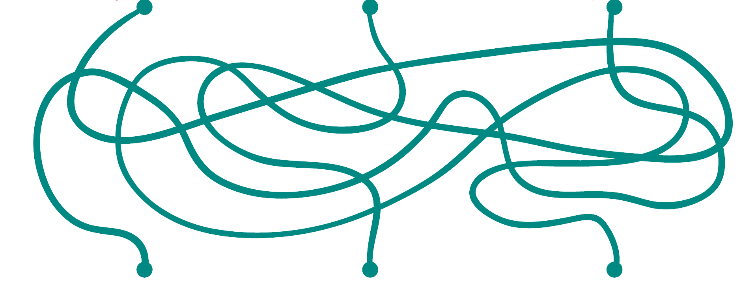
Find the path.
Game on possessive case.

Slide 2

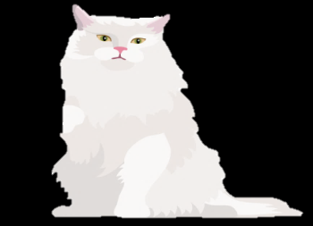


Robert
Judy
Linda
It’s Linda’s parrot .

Slide 3


Robert
Judy
Linda
It’s Robert’s dog.
It’s Linda’s parrot .

Slide 4

Robert
Judy
Linda
It’s Robert’s dog.
It’s Judy’s cat.
It’s Linda’s parrot .

Slide 5







My daddy
My mummy
My brother
It’s my brother’s digital camera .

Slide 6
My daddy
My mummy
My brother
It’s my mummy’s mobile phone.
It’s my brother’s digital camera .

Slide 7


My daddy
My mummy
My brother
It’s my daddy’s
laptop.
It’s my mummy’s mobile phone.
It’s my brother’s digital camera .

Slide 8





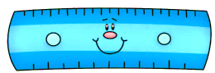
My teacher
My twin sisters
My classmate
They are my twin sisters’ books

Slide 9

My teacher
My twin sisters
My classmate
It’s my teacher’s
pen.
They are my twin sisters’ books

Slide 10
My teacher
My twin sisters
My classmate
It’s my teacher’s
pen.
They are my twin sisters’ books
It’s my classmate’s ruler .

Slide 11


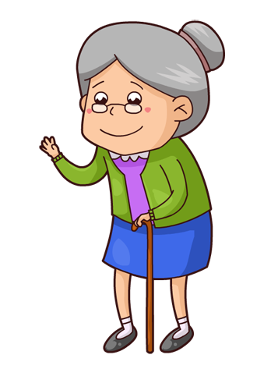







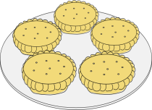
Girls
Women
My grandma
They are women’s bags.

Slide 12
Girls
Women
My grandma
They are women’s bags.
They are my granndma’s pies .

Slide 13
Girls
Women
My grandma
They are girls’ toys.
They are women’s bags.
They are my granndma’s pies .

Slide 14




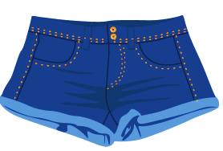


My friend
My cousin
My neighbor
They are my friend’s shorts.

Slide 15
My friend
My cousin
My neighbor
They are my friend’s shorts.
They are my neighbor’s socks.

Slide 16
My friend
My cousin
My neighbor
They are my friend’s shorts.
It’s my cousin’s
scarf.
They are my neighbor’s socks.

Slide 17






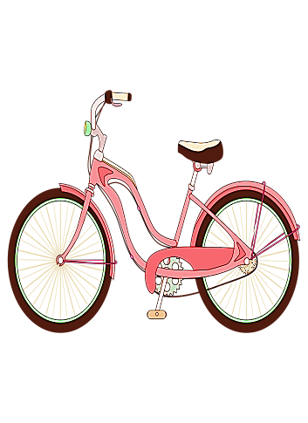

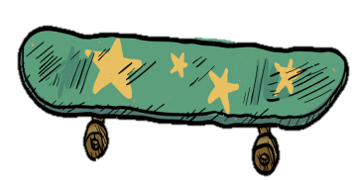
Tree
Boris
Carla and Jane
They are Carla’s and Jane’s bikes.

Slide 18



Tree
Boris
Carla and Jane
They are leaves of tree.
They are Carla’s and Jane’s bikes.

Slide 19



Tree
Boris
Carla and Jane
They are leaves of tree.
It’s Boris’s (Boris’)
skateboard.
They are Carla’s and Jane’s bikes.

